Slide 1
Is Turing Taking Your Tests? Recent Developments in AI, and How They May Impact Your Teaching.
Presented by
Robert Cummings, Executive Director of Academic Innovation
Marc Watkins, Lecturer of Writing and Rhetoric

Slide 2
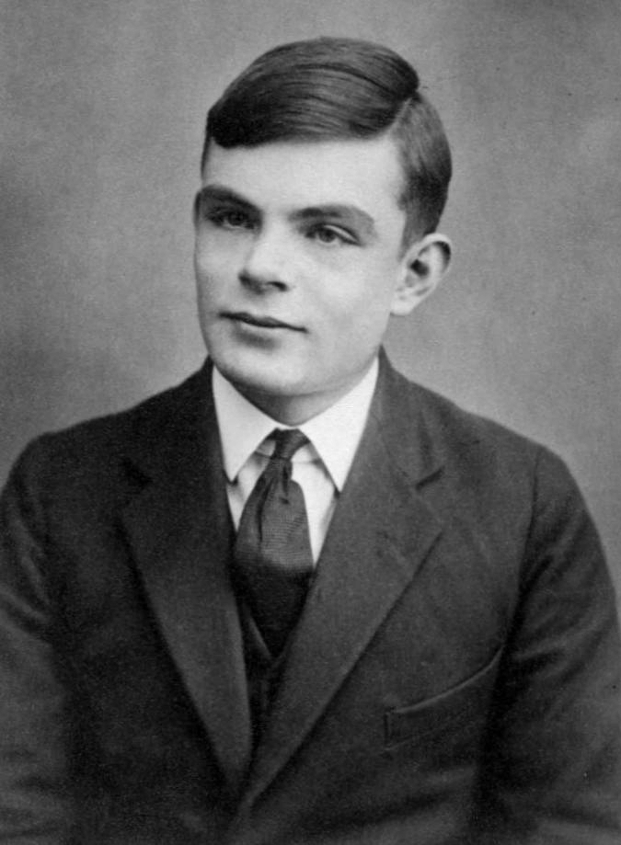
Who was Alan Turing and why are we referencing him?
Lived 23 June 1912 – 7 June 1954
Mathematics at Cambridge (1934)
Ph.D. Mathematics Princeton (1938)
Worked in mathematics, computer science, logic, cryptography, philosophy, theoretical biology.
Was persecuted for being homosexual, and died of likely suicide.
Received posthumous apology (2009) and pardon (2013) in the UK.
Alan Turing aged 16 around 1928. Image credit Wikimedia Commons.
Notes:
Lived 23 June 1912 – 7 June 1954.
Earned undergraduate degree in Mathematics at Cambridge (1934), Ph.D. Mathematics Princeton (1938).
Worked in mathematics, computer science, logic, cryptography, philosophy, theoretical biology.
Was persecuted for being homosexual, and died of likely suicide.
Received posthumous apology (2009) and pardon (2013) in the UK.

Slide 3
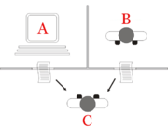
The Turing Test, a.k.a., The Imitation Game
"Computer Machinery and Intelligence."
"The Imitation Game."
Are you playing?
The Imitation Game. Image Credit: Wikimedia Commons
Notes:
One of many important accomplishments we would reference today was the Turing Test. In his paper ”Computer Machinery and Intelligence” Turing created a game known as ”The Imitation Game.”
In the Imitation Game, an interrogator observes a text-only conversation between two unknown players. One of the uknown players is human; the other is a computer. The interrogator can ask text-only questions of both entities. The interrogator must ultimately guess the identity of the player, and if the computer can fool the interrogator in to thinking it is human, then it has won the imitation game.
Our question for you today: when you give students a test, are you now playing the imitation game?

Slide 4
What is Artificial Intelligence?
The field of artificial intelligence is poorly named.
“getting machines to do specific tasks that currently require human brains” –AI Researcher Michael Wooldridge
Interdisciplinary
philosophy
psychology
cognitive science
neuroscience
logic
statistics
economics
robotics
linguistics
Home → Computer Science
Image Credit: DALL·E 2
Notes:
The mainstream of Artificial Intelligence research is not focused on replacing human intelligence, or building machines that are self-aware, sentient, or conscious like humans.
“The mainstream of AI research today is focused around getting machines to do specific tasks that currently require human brains (and also, potentially, human bodies) and for which conventional computing techniques provide no solution.” (Wooldridge).
Thus, it is a very interdisciplinary pursuit, with research from philosophy, psychology, cognitive science, neuroscience, logic, statistics, economics, robotics, and linguistics.
But AI remains primarily at home in computer science.

Slide 5
The Advent of Natural Language Processing
Natural Language Processing, or NLP
Human communication through language
Breakthrough Process of Neural Networks
Large Language Models
Example: OpenAI
Image Credit: DALL·E 2
Notes:
The particular branch of AI we are most concerned with today is Natural Language Processing, or NLP.
NLP has the goal of addressing human communication through language, which is made difficult by context, nuance, and ever-evolving usage.
The recent development of deep neural networks has created breakthroughs in NLP.
Natural language processing strategies are now being applied to extremely large data sets, or large language models.
One example is a project named OpenAI

Slide 6
What is Open AI?
Hosted on the Microsoft cloud and Microsoft holds the exclusive license
Large Language Model called GPT-3 about 175B parameters. It is trained on about 45TB of text data from different datasets
Can generate text, audio, and images
Over 300 companies are developing apps based on the technology
Notes:
Open Ai launched in 2020 and developers were given access to start producing apps powered by GPT-3
Over 300 apps have since launched powered by GPT-3
The McKinsey Institute predicts that 70% of businesses and workers will come into daily contact with AI by 2030
GPT-3 was originally designed as a blogging tool built for creating content on the internet using data scraped from the internet
OpenAI announced Open Beta access in May of this year. Anyone can sign up and create an account

Slide 7
How Will the Rise of AI Writing Assistants Impact Higher Education?
AI writing assistants will likely disrupt university teaching in a number of ways. For one, AI-assisted writing can help students write more accurately and concisely, which may reduce the need for face-to-face interaction with professors. Additionally, AI may be able to provide real-time feedback on student writing, making it easier for professors to identify areas where students need improvement. Finally, AI writing assistants could eventually become so sophisticated that they are able to generate entire essays or papers on their own, which would greatly reduce the amount of time professors spend grading student work.
Notes:
Once a blogging tool, recent developments and improvements in GPT-3 now means that it can generate competent, credible, and complete responses to complex questions.
The disruption LLMs will cause in Higher Ed and K-12 will be immense. Ethical considerations of authorship, authenticity, and attributing sources will be common across most disciplines.
For millennia, we’ve equated the act of writing with thinking, when writing and language are in fact technologies. We aren’t prepared for LLM’s ability to mimic writing let alone thinking.
It’s important to remember that there is no reasoning or sentience behind an AI’s Output—LLMs are essentially stochastic parrots.

Slide 8
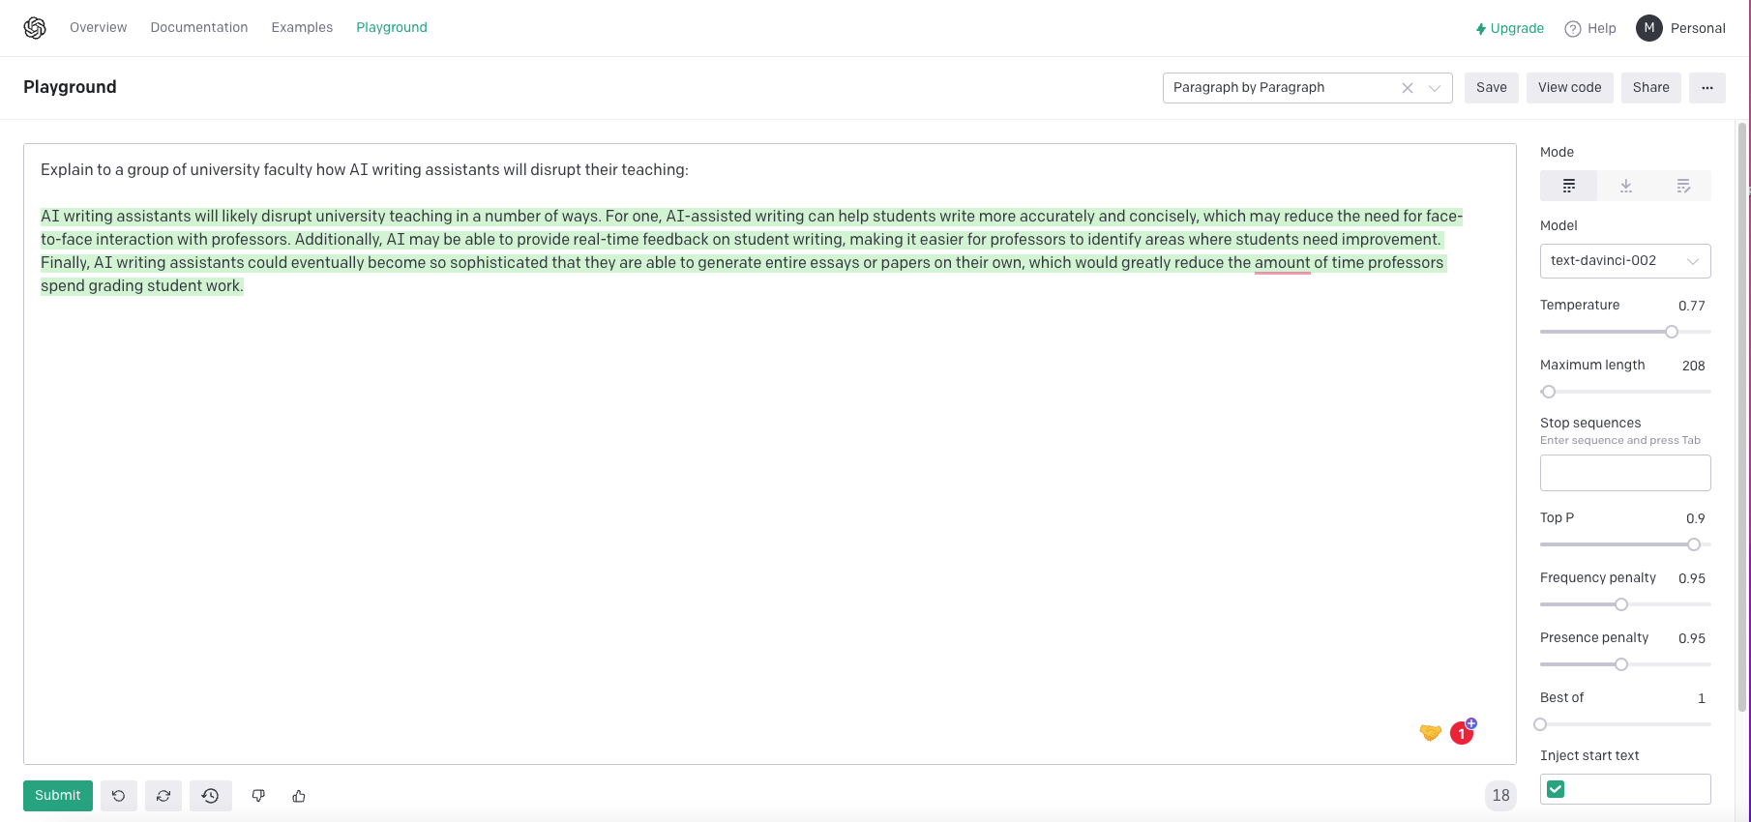
That was written by an AI!
Notes:
Many of our students, indeed some of our colleagues, may struggle with discerning writing that is AI-generated vs. writing that is drafted organically.
We will likely need to develop new language and explore setting boundaries for the use of AI writing assistants.
Since AI-generated writing has no author and cannot be copyrighted, there is no plagiarism
There is no reliable means to detect AI writing vs. organically composed writing.
Even if AI writing detectors are invented, millions of people will be using AI writing assistants in publications (NYT & WaPo currently use AI generators for article stubs).

Slide 9
Two AI-generated essays
What can current AI writing assistants produce?
Easily answer short form questions
Produce essays of a C or B- quality in minutes through prompt engineering--a process of entering commands in the API to shape an output
Write in a variety of genres, tones, and personas for a multitude of audiences
I generated two essays with Open AI's API, Hyperwrite- a GPT-3 powered app, and Quillbot-Coursehero's paraphrasing AI.
Each essay took between 10-20 minutes to compose
Test 1 cost me $1.20 to produce, while Test 2 was free
Notes:
While AI writing can produce competent, credible and complete short answer responses easily they struggle to produce essay-length responses.
One needs a great deal of content knowledge, rhetorical knowledge, context, and a clear grasp of the writing process to actually produce such an output with an AI.
Critical thinking skills remain vital, as the AI has no sense of direction or purpose and will often drift off into nonsense without clear prompting
Still, as this technology is adopted in K-12, we will likely see more and more students who are proficient at using AI writing assistants.

Slide 10
Developers
Open AI (GPT-3)
Meta OPT175B powering ALPA and Blenderbot 3
Cohere. AI (similar to OpenAI, down to its API)
BLOOM (French multi-language system at the size of 176 billion)
AI21 Studio NIVIDA's AI Tool Demo Playground
Stability AI (Image, Text, and Multimodal projects)
Notes:
Launch OpenAI Demo

Slide 11
Text to Image Generators

Slide 12
Tools-Fermat
Fermat
a GPT-3 powered AI writing assistant that allows students to brainstorm and compose writing on a moveable spatial canvas using OpenAI's API and DALLE.
Fermat’s AI Writing Assistant
Fermat’s DALL-E Plugin
Notes:
Launch Demos

Slide 13
Tools-Elicit
Elicit
a GPT-3 powered research assistant designed to help craft research questions and generate a lit review of scholarly sources.
Elicit’s Lit Review Generator
Elicit’s Brainstorm Research Questions
Notes:
Launch demo and transition to teaching and learning implications-Bob

Slide 14
Teaching and Learning Implications
Writing to learn
Writing to demonstrate learning.
“Writing to Learn” Image Credit: Stable Diffusion.
Notes:
When we think about teaching and learning implications for AI-powered writing assistants, it is helpful to think about Writing Across the Curriculum models. In Writing Across the Curriculum, we typically say that our purposes are either:
Writing to learn; or
Writing to demonstrate learning.
For most classrooms, this model will also hold for thinking through how AI-powered writing assistants and AI-powered writing generators will impact our teaching and learning practices.

Slide 15
Teaching and Learning Implications: Writing to Learn
How will AI-powered Writing Generators affect writing to learn?
Invention
Research
Summary
Counter-arguments and diversification of viewpoints.
“Writing to Learn” Image Credit: Stable Diffusion.
Notes:
How will AI-powered Writing Generators affect writing to learn?
Invention: AI-powered Writing Generators can help students explore their thinking, formulate ideas, and refine their claims.
Research: AI-powered Writing Generators can help students to identify sources for ideas (e.g., Elicit).
Summary: AI-powered Writing Generators can help students to summarize complex ideas.
Counter-arguments and diversification of viewpoints: AI-powered Writing Generators can help students identify multiple perspectives for their ideas.

Slide 16
Teaching and Learning Implications: Writing to Learn: Packback
Notes:
It’s not all doom and gloom.
Packback is an example of one responsible use of AI powered writing assistance that has been in use for years.
This tool has been used, or is currently being used, by UM faculty, like Dr. Merv Matthew (Psychology) and Dr. Jason Solinger (English)
Packback has several features, but a central application is coaching students to write more open-ended questions and engage their curiosity in online class discussion boards.
Dr, Matthew recently gave a compelling presentation about how Packback was used in his psychology classes to help improve critical thinking.

Slide 17
Teaching and Learning Implications: Writing to Demonstrate Understanding
AI-powered writing generators are incompatible with writing to demonstrate understanding.
In these formats (e.g., testing, research papers), all thinking needs to be the original expression of students, or clearly attributed to others using accepted rules of citation.
Student use of AI to produce writing that is not their own thinking will not demonstrate their understanding of a topic.
“Writing to Demonstrate Understanding” Image Credit: Stable Diffusion.

Slide 18
Comparison to Search?
Wikipedia
Is it an encyclopedia?
Close enough.
Image Credit: Wikimedia Commons
Notes:
Whenever a new concept emerges, we tend to compare it to familiar and well-known concepts.
For instance, think about Wikipedia. When it first arrived, it seemed like chaos. How could “a bunch of nobodies” ever come together "'to create and distribute a free encyclopedia of the highest possible quality to every single person on the planet in their own language”?
But in order for Wikipedia to become whatever it is today, it had to name itself as an encyclopedia. By borrowing the term “encyclopedia,” it instantly defined how it saw itself, what role it hoped to fulfill, how volunteers should organize themselves, and what value it hoped to deliver to users.

Slide 19
Comparison to Search ?
Is AI powered writing generation similar to Google search?
input→
database matching→
output.
No sentience.
Notes:
I would invite you to think about the AI-powered writing assistants we are talking about today – at least the large language models as an updated version of web search tools, such as Google search. (This analogy doesn’t work as well for the visual AI tools.)
As you know, when you enter a word, a phrase, a sentence, or even several sentences in to Google’s web search, it will immediately search the web for websites and other resources related to your input. The output will be a list of websites, images, and maybe an information panel constructed on the fly.
It might be useful to think about GPT-3 usages in the same vein.
Behind the scenes with your Google search, a web crawler is scanning billions of tags from websites in attempt to match your input with the content on those websites.
Behind the scenes with a GPT-3 Playground inquiry, your input is broken down into tokens (or groups of characters) and associated with tokens in the massive GPT-3 database, using algorithms to predict the best arrangements of matched token output.
The rough similarity = input→database matching→output.
But in either case, there is no sentience behind the output.

Slide 20
AI Bias & Hate Speech
AI is trained on massive material pulled at random from the internet. Any biases found within the training data will also be reproduced in the actual output
Racism, sexism, hate speech, etc. are all included within the training data
Users need to be aware of this and not trust an output at face value
Notes:
All the bias found within the training data can be reproduced within an AI’s output.
Language biases include sexism toward women and racist stereotypes. Including example of typing “Islam” or “Muslim” and having GPT-3 generate a report about terrorism or bombings
Images are biased as well. Typing in a “beautiful woman” defaults to a white, European image. Typing in “Jesus” produces a white European response.
Image generators, like the recent open release of Stable Diffusion can create images or self-harm, pornography, and child abuse

Slide 21
Next Steps
Academic Outreach: Planning for Future Disruptions: Resilient Teaching Beyond the Pandemic
10/17/22 @ 10:00 a.m.
Lamar Hall Conference Room 323
This workshop will serve as a launching pad to a learning community on the subject of planning for future disruptions in higher education, with a focus on how AI text and image generators will impact how students learn and how faculty teach. Members of this learning community will be introduced to GPT-3, OpenAI’s language generator, and OpenAI’s image generator, DALL-E. Microsoft now exclusively hosts and licenses all GPT-3 powered apps and many of these are geared toward writing short and even long form essay responses. After the workshop concludes, members of the learning community will be invited to participate virtually in a Blackboard community, where they can receive and share resources and continue a discussion about how these recent advances will disrupt higher education.
CETL: AI and Data Science Developments and Their Impact on Higher Ed
10/28/22 @ 12:00 p.m.
Johnson Commons East Ballroom
Most every field of intellectual inquiry is today engaging Artificial Intelligence and Data Science, and asking how we can prepare our graduates to work alongside AI in their careers. On our campus, and in our region, curiosity about AI and its impact on higher education are at an all time high. In this session we will look briefly at how we arrived at this moment in AI history, highlight local and regional developments in AI, and examine plans for undergraduate education. We will also identify professional development and research funding opportunities.
Notes:
We will be hosting a number of events this fall to help faculty explore these implications in further workshops and a faculty learning community.
The FLC will be asynchronous and last several weeks before it is archived.
Resources, examples, and the start of a discourse community about AI writing and teaching

Slide 22
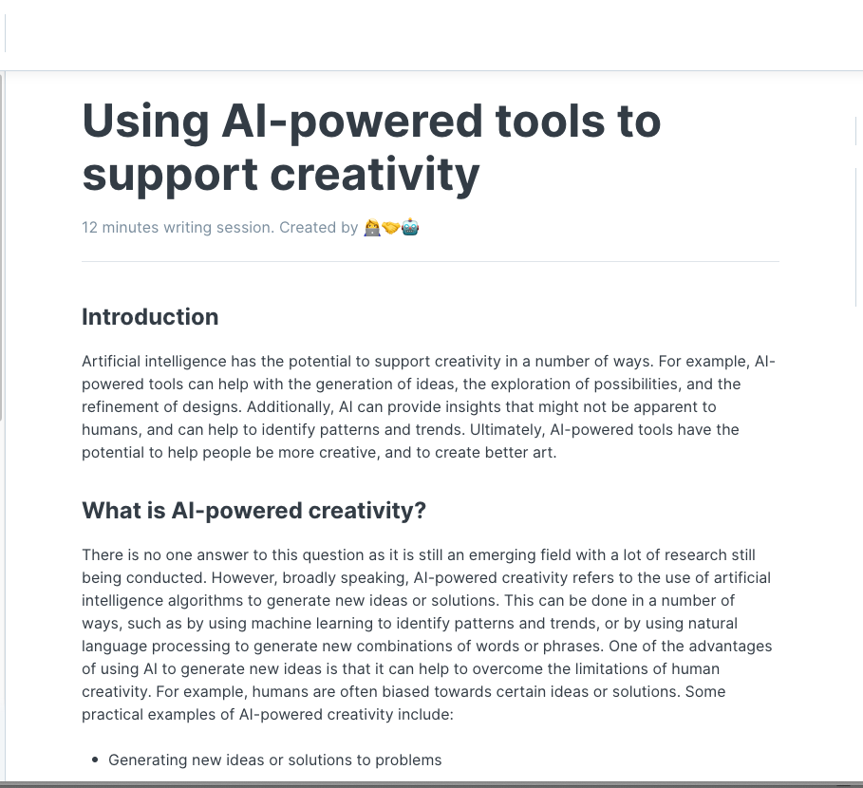
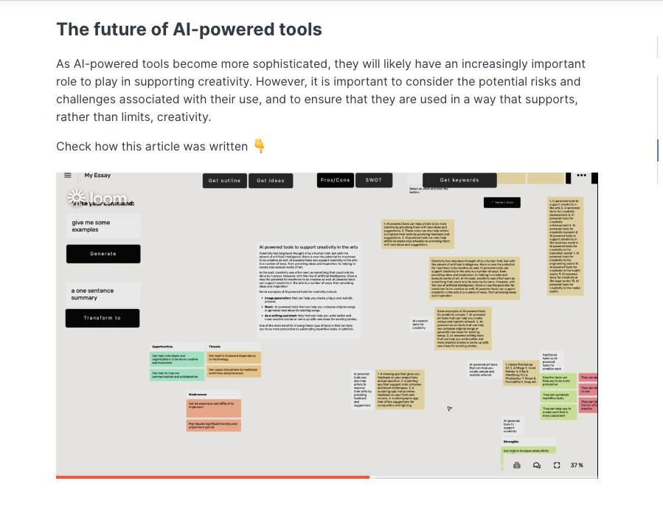
How your handout was generated

Slide 23
References
Wooldridge, Michael. A Brief History of Artificial Intelligence: What It Is, Where We Are, and Where We Are Going. New York: Flatiron Books, 2021.

